Slide 1
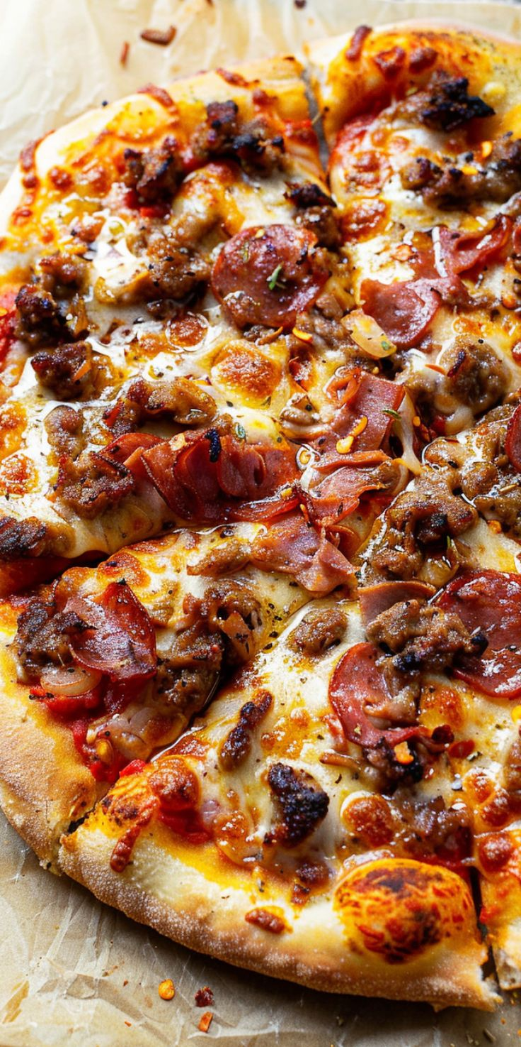
From Dough to Dollars
A Data Driven Sales Analysis of Delicious Pizza Co.
Prepared by: Beatrice Wambui Wakonyo
Date : February,2026
Tool Used: MySQL | PowerPoint | Dashboard

Slide 2

Data Exploration & Findings
Revenue Overview
The total revenue generated over the entire year
SELECT
SUM(total_price) AS Total_Revenue
FROM delicious_pizza_analytics_table;

Slide 3

The average order value
SELECT
SUM(total_price)/COUNT(DISTINCT order_id) AS Average_Order_Value
FROM delicious_pizza_analytics_table;

Slide 4

The total pizzas sold
SELECT
SUM(quantity) AS Total_Pizza_Sold
FROM delicious_pizza_analytics_table;

Slide 5

unique orders placed
SELECT
COUNT(DISTINCT order_id) AS Unique_Orders_Placed
FROM delicious_pizza_analytics_table;

Slide 6
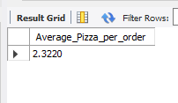
The average number of pizzas per order
SELECT
SUM(quantity)/COUNT(DISTINCT order_id) AS Average_Pizza_per_order
FROM delicious_pizza_analytics_table;

Slide 7
What the Data Revealed
Revenue Summary Overview
Delicious Pizza generated a total revenue of $817,860 over the year, reflecting a strong overall performance for a single location pizza operation. With 49,574 pizzas sold across 2,130 unique orders, the business averaged 2.32 pizzas per order and an average order value of $38.30, indicating that customers consistently order for groups rather than individual meals. This pattern suggests the core customer base is families or small gatherings, which presents a clear opportunity to introduce meal deal bundles or family packages that could push the average order value even higher. However, the relatively low number of unique orders at 2,130 across a full year raises a question about daily customer footfall and whether the business is overly reliant on a smaller pool of repeat or bulk customers. Growing the number of unique orders through new customer acquisition should be a priority for the year ahead.

Slide 8
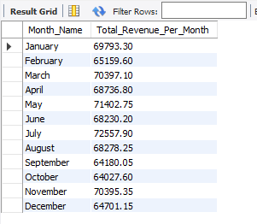
Sales Trends Over Time
Monthly revenue totals
SELECT
MONTHNAME(order_date) AS Month_Name,
SUM(total_price) AS Total_Revenue_Per_Month
FROM delicious_pizza_analytics_table
GROUP BY Month_Name;

Slide 9

Month performed best by revenue
SELECT
SUM(total_price) AS Total_Revenue,
MONTHNAME(order_date) AS Month_Name
FROM delicious_pizza_analytics_table
GROUP BY Month_Name
ORDER BY Total_Revenue DESC
LIMIT 1;

Slide 10

Month performed worst
SELECT
SUM(total_price) AS Total_Revenue,
MONTHNAME(order_date) AS Month_Name
FROM delicious_pizza_analytics_table
GROUP BY Month_Name
ORDER BY Total_Revenue
LIMIT 1;

Slide 11

Day of the week generates the highest number of orders
SELECT
SUM(total_price) AS Total_Revenue,
DAYNAME(order_date) AS Day_Name
FROM delicious_pizza_analytics_table
GROUP BY Day_Name
ORDER BY Total_Revenue DESC
LIMIT 1;

Slide 12

Day of the week that generates the lowest number of orders
SELECT
SUM(total_price) AS Total_Revenue,
DAYNAME(order_date) AS Day_Name
FROM delicious_pizza_analytics_table
GROUP BY Day_Name
ORDER BY Total_Revenue
LIMIT 1;

Slide 13

The hour of the day with the most orders placed
SELECT
HOUR(order_time) AS Hour_Name,
SUM(total_price) AS Total_Hour_Revenue
FROM delicious_pizza_analytics_table
GROUP BY Hour_Name
ORDER BY Total_Hour_Revenue DESC
LIMIT 1;

Slide 14
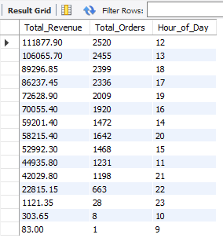
Plot or describe the distribution across the day.
SELECT
SUM(total_price) Total_Revenue,
COUNT(DISTINCT order_id) AS Total_Orders,
HOUR(order_time) Hour_of_Day
FROM delicious_pizza_analytics_table
GROUP BY Hour_of_Day
ORDER BY Total_Revenue DESC;

Slide 15
Sales Trends Over Time Summary
Delicious Pizza demonstrates relatively stable monthly revenue performance, with July recording the highest monthly revenue at $72,557.90 and October registering the lowest at $64,027.60. The variance between the two is approximately 13%, which reflects a healthy revenue floor rather than an alarming gap. That said, October consistently underperforms and warrants attention targeted promotions, limited time offers, or seasonal menu additions during that month could close the gap and push October closer to the annual average.
At the weekly level, Friday is the strongest revenue day at $136,073.90, driven by predictable end-of-week behavior including social gatherings, family meals, and customers treating themselves after the work week. Sunday generates the least revenue at $99,203.50, likely because it lacks the social triggers that drive Friday demand people tend to have quieter, more routine Sundays with less motivation for celebratory meals. Rather than accepting Sunday as a weak day, the business could introduce a Sunday family bundle or discount offer to stimulate demand on an otherwise slow day.

Slide 16
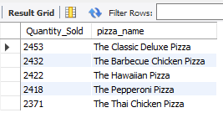
Pizza Performance
The top 5 best-selling pizzas by quantity sold
SELECT
SUM(quantity) AS Quantity_Sold,
pizza_name
FROM delicious_pizza_analytics_table
GROUP BY pizza_name
ORDER BY Quantity_Sold DESC
LIMIT 5;

Slide 17
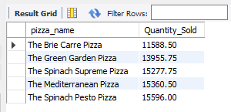
The bottom 5 worst-selling pizzas by quantity sold
SELECT
pizza_name,
SUM(total_price) AS Quantity_Sold
FROM delicious_pizza_analytics_table
GROUP BY pizza_name
ORDER BY Quantity_Sold
LIMIT 5;

Slide 18

Pizza generates the most revenue
SELECT
pizza_name,
SUM(total_price) AS Total_Revenue
FROM delicious_pizza_analytics_table
GROUP BY pizza_name
ORDER BY Total_Revenue DESC
LIMIT 1;

Slide 19

Pizza generates the least revenue
SELECT
pizza_name,
SUM(total_price) AS Total_Revenue
FROM delicious_pizza_analytics_table
GROUP BY pizza_name
ORDER BY Total_Revenue
LIMIT 1;

Slide 20

Best-sellers by quantity compared to the Best-sellers by revenue
WITH BY_Quantity_Sold AS (
SELECT
SUM(quantity) AS Quantity_Sold,
pizza_name,
RANK() OVER(ORDER BY SUM(quantity) DESC) AS Quantity_Rank
FROM delicious_pizza_analytics_table
GROUP BY pizza_name
),
BY_Total_Revenue AS(
SELECT
pizza_name,
SUM(total_price) AS Total_Revenue,
RANK() OVER(ORDER BY SUM(total_price) DESC) AS Revenue_Rank
FROM delicious_pizza_analytics_table
GROUP BY pizza_name
)
SELECT
qs.pizza_name,
qs.Quantity_Sold,
tr.pizza_name,
tr.Total_Revenue
FROM BY_Quantity_Sold qs
JOIN BY_Total_Revenue tr
ON qs.Quantity_Rank=1 AND Revenue_Rank=1;

Slide 21
Pizza Performance
Among the 49,574 pizzas sold, the Classic Deluxe Pizza emerged as the top seller by quantity with 2,453 units sold, reflecting strong and consistent customer demand for this product. At the other end of the spectrum, the Spinach Pesto Pizza recorded the lowest quantity sold, sitting significantly behind the store's bestseller. Rather than viewing this as an immediate risk, the business should monitor whether the Spinach Pesto's low performance is driven by poor visibility on the menu, limited marketing, or genuine lack of customer interest before deciding whether to retain or retire it.
From a revenue perspective, the Thai Chicken Pizza generated the highest revenue at $43,434.25, representing approximately 5.3% of total store revenue a notable contribution for a single pizza type. The Brie Carre Pizza generated the least revenue at $11,588, contributing roughly 1.4% to total revenue. The gap between the highest and lowest revenue-generating pizzas is meaningful and suggests that premium ingredient pizzas like the Thai Chicken command both higher prices and stronger customer willingness to pay.
The most important insight in this section is that the best seller by quantity and the best seller by revenue are not the same pizza. The Classic Deluxe Pizza leads in units sold while the Thai Chicken Pizza leads in revenue, which reveals that the Classic Deluxe is likely a lower priced, high volume product while the Thai Chicken is a premium priced, moderate volume product. Rather than raising the price of the Classic Deluxe and risking a drop in its popularity, the store should focus on upselling larger sizes of the Classic Deluxe and promoting the Thai Chicken more visibly to customers who may not yet be aware of it. A combination of volume from the Classic Deluxe and premium revenue from the Thai Chicken is the most balanced path to maximizing overall pizza performance.

Slide 22
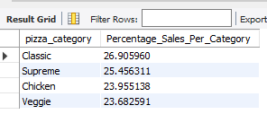
Category & Size Analysis
Percentage of total sales by each pizza category
WITH Total_Revenue AS(
SELECT
SUM(total_price) AS Total_Sales
FROM delicious_pizza_analytics_table
),
Revenue_By_Category AS (
SELECT
SUM(total_price) AS Sales_per_Category,
pizza_category
FROM delicious_pizza_analytics_table
GROUP BY pizza_category
)
SELECT
pizza_category,
(Sales_per_Category/Total_Sales)*100 AS Percentage_Sales_Per_Category
FROM Total_Revenue, Revenue_By_Category
ORDER BY Percentage_Sales_Per_Category DESC;

Slide 23

The most popular pizza size by number of orders
SELECT
COUNT(DISTINCT order_id) AS Total_Orders,
pizza_size
FROM delicious_pizza_analytics_table
GROUP BY pizza_size
ORDER BY Total_Orders DESC
LIMIT 1;

Slide 24

Pizza size by Revenue in comparison to quantity sold
WITH BY_Revenue AS (
SELECT
SUM(total_price) AS Total_Revenue,
pizza_size,
RANK() OVER(ORDER BY SUM(total_price) DESC) Revenue_Rank
FROM delicious_pizza_analytics_table
GROUP BY pizza_size
),
BY_Quantity_Sold AS (
SELECT
COUNT(DISTINCT order_id) AS Total_Orders,
pizza_size,
RANK() OVER(ORDER BY COUNT(DISTINCT order_id) DESC) AS Quantity_Rank
FROM delicious_pizza_analytics_table
GROUP BY pizza_size
)
SELECT
br.pizza_size,
br.Total_Revenue,
qs.pizza_size,
qs.Total_Orders
FROM BY_Revenue br
JOIN BY_Quantity_Sold qs
ON br.Revenue_Rank=1 AND qs.Quantity_Rank=1;

Slide 25

category with the highest average unit price
SELECT
AVG(unit_price) AS Average_Unit_Price,
pizza_category
FROM delicious_pizza_analytics_table
GROUP BY pizza_category
ORDER BY Average_Unit_Price DESC
LIMIT 1;

Slide 26
Category & Size Analysis Summary
Delicious Pizza offers pizzas across four categories and the sales distribution is remarkably balanced. The Classic category leads with 26.90% of total sales while the Veggie category records the lowest contribution at 23.68%. The gap between the highest and lowest performing category is only 3.22 percentage points, which indicates that customer demand is spread evenly across the menu rather than being concentrated in one area. This is a healthy sign for the business as it reduces dependency on any single category and suggests the menu is well designed to appeal to a broad range of customer preferences.
From a size perspective, the data tells a clear and decisive story Large pizzas dominate. With 12,736 orders, Large accounts for 59.65% of all orders placed and generates the highest revenue among all sizes at $375,318.70. This pattern holds consistently across both volume and revenue metrics, confirming that customers have a strong and deliberate preference for Large pizzas. This presents a direct upselling opportunity — customers ordering Medium pizzas should be encouraged by staff or prompted digitally to upgrade to Large, as the incremental price difference is likely small relative to the perceived value gain for the customer.
On pricing, the Chicken category carries the highest average unit price at $17.70, reflecting the premium cost of chicken-based ingredients relative to Classic or Veggie options. Despite being the most expensive category on average, if Chicken pizzas maintain strong sales volume it signals that customers perceive good value at that price point. The business should protect the Chicken category's pricing integrity and resist discounting it, as doing so could undermine its premium positioning while only marginally boosting short term volume.

Slide 27
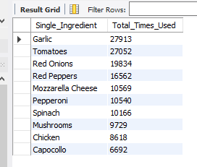
Ingredient Intelligence
The top 10 most frequently used ingredients across all pizzas sold
WITH Exploded AS (
SELECT
TRIM(ingredient.value) AS Single_Ingredient,
quantity
FROM delicious_pizza_analytics_table,
JSON_TABLE(
CONCAT('["', REPLACE(pizza_ingredients, ', ', '","'), '"]'),
'$[*]' COLUMNS (value VARCHAR(100) PATH '$')
) AS ingredient
)
SELECT
Single_Ingredient,
SUM(quantity) AS Total_Times_Used
FROM Exploded
GROUP BY Single_Ingredient
ORDER BY Total_Times_Used DESC
LIMIT 10;

Slide 28
Ingredients that appear exclusively in low-selling pizzas
WITH Pizza_Sales AS (
SELECT
pizza_name,
SUM(quantity) AS Total_Quantity
FROM delicious_pizza_analytics_table
GROUP BY pizza_name
),
Low_Sellers AS (
SELECT pizza_name
FROM Pizza_Sales
ORDER BY Total_Quantity ASC
LIMIT 5
),
All_Ingredients AS (
SELECT
TRIM(ingredient.value) AS Single_Ingredient,
pizza_name
FROM delicious_pizza_analytics_table,
JSON_TABLE(
CONCAT('["', REPLACE(pizza_ingredients, ', ', '","'), '"]'),
'$[*]' COLUMNS (value VARCHAR(100) PATH '$')
) AS ingredient
GROUP BY Single_Ingredient, pizza_name
),
Low_Seller_Ingredients AS (
SELECT DISTINCT ai.Single_Ingredient
FROM All_Ingredients ai
JOIN Low_Sellers ls ON ai.pizza_name = ls.pizza_name
),

Slide 29
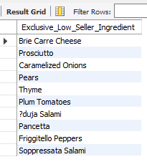
Ingredients that appear exclusively in low-selling pizzas
High_Seller_Ingredients AS (
SELECT DISTINCT ai.Single_Ingredient
FROM All_Ingredients ai
WHERE ai.pizza_name NOT IN (SELECT pizza_name FROM Low_Sellers)
)
SELECT
lsi.Single_Ingredient AS Exclusive_Low_Seller_Ingredient
FROM Low_Seller_Ingredients lsi
LEFT JOIN High_Seller_Ingredients hsi
ON lsi.Single_Ingredient = hsi.Single_Ingredient
WHERE hsi.Single_Ingredient IS NULL;

Slide 30
Ingredients Intelligence
A closer look at ingredient usage across all pizzas sold reveals clear patterns that carry direct implications for inventory management and menu strategy. Garlic leads as the most used ingredient, appearing across pizzas sold a weighted total of 27,913 times, followed closely by Tomatoes at 27,052. These two ingredients form the flavor foundation of the majority of pizzas on the menu and their consistent high usage means any supply disruption for either would have a store wide impact. The top 10 most used ingredients in descending order are Garlic, Tomatoes, Red Onions, Red Peppers, Mozzarella Cheese, Pepperoni, Spinach, Mushrooms, Chicken, and Capocollo with usage values ranging from 27,913 down to 6,692. The business should ensure these ingredients are prioritized in procurement planning, with Garlic and Tomatoes treated as critical stock items that should never fall below a safe minimum threshold.
On the other end of the spectrum, several ingredients appear exclusively in low selling pizzas including Brie Carre Cheese, Prosciutto, Caramelized Onions, Pears, Thyme, Plum Tomatoes, Duja Salami, Pancetta, Friggitello Peppers, and Soppressata Salami. Before making any decision to remove these ingredients from procurement, the business should conduct a two-step evaluation. First, examine the revenue generated by the pizzas that use these ingredients to determine whether low sales volume is compensated by a high unit price. Second, examine the order frequency of those pizzas to determine whether they attract a small but loyal customer segment that would be lost if the product was removed. Only after both checks should a retirement decision be made. Ingredients that appear in pizzas with both low order counts and low revenue contribution represent the clearest candidates for removal, which would simplify the supply chain, reduce waste, and lower overall food costs without meaningfully impacting customer satisfaction.

